Slide 1
Multi Topic Classification using Transformers
Venkata Sai Krishna Abbaraju
Sumukh Nitundila

Slide 2
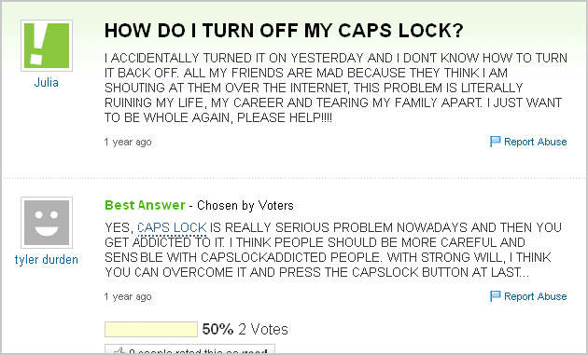
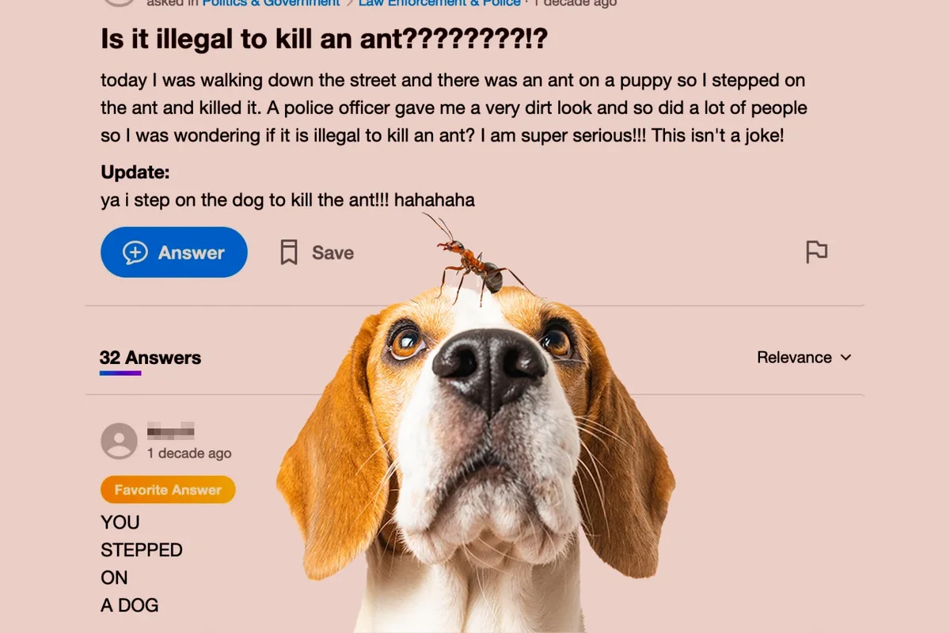
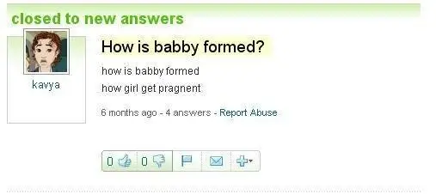
Introduction
Problem statement: The objective is to automatically categorize a question posted by a user on Yahoo Answers platform. The actual dataset consists of 10 classes and 1.5 million rows of different languages.

Slide 3
Project Architecture
Postgres
Extract files as csv
Colab - GPU
Kaggle
Preprocess
XAI
Model selection
Model building

Slide 4
Data Preprocessing
Challenges:
Lots of web content, math symbols, contractions etc. Spacy has a lots of builtins that helped us.
Dataset is multilingual. To overcome this challenge we narrowed the scope to only english text.
We used models like languid (nltk), langdetect (google) and XLnet (transformer) to filter non-english texts.
Data Cleaning took ~65% of the time. Since this dataset is so huge, we worked on a subset of 4 categories (Culture, Sports, Computers, Politics) spanning 20,000 rows

Slide 5
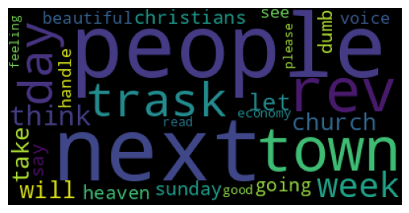
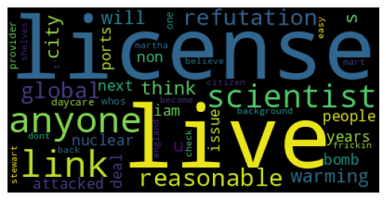
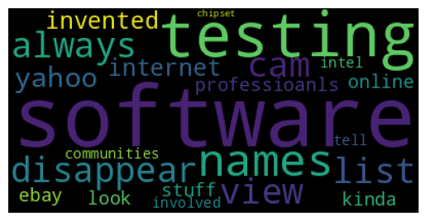
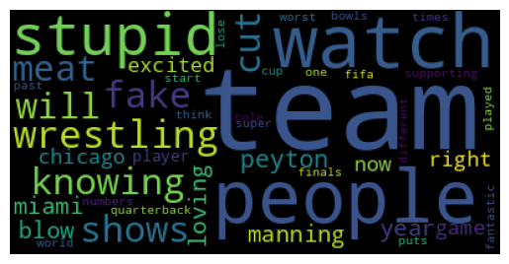

Slide 6
Why use Transformers?
Have tokenization mechanisms that can better handle unseen words.
Lack of contextuality in ML. Only short term memory. Transformers have attention mechanism which helps with context.
Pre trained models available to us.

Slide 7
Methods - SOTA Transformers
Attribute | BERT by Google | RoBERTa by Facebook
Tokenizer | Word Piece - 30k tokens vocab | Byte pair - more than 138k tokens of vocab
Architecture | 12 encoders; 110 mil parameters | 12 encoders; 110 mil parameters
Pre training scheme | Masked Language Model, Next Sentence Prediction | MLM, Dynamic masking

Slide 8
Sample tokenization
sentence : “ question for jews: what is the rabenishalelem ? is that god? “
BERT:
['question', 'for', 'jews', ':', 'what', 'is', 'the', 'ra', '##ben', '##isha', '##le', '##lem', '?', 'is', 'that', 'god', '?']
RoBERTa:
['question', 'Ġfor', 'Ġjew', 's', ':', 'Ġwhat', 'Ġis', 'Ġthe', 'Ġrab', 'en', 'ish', 'ale', 'lem', 'Ġ?', 'Ġis', 'Ġthat', 'Ġgod', '?']

Slide 9
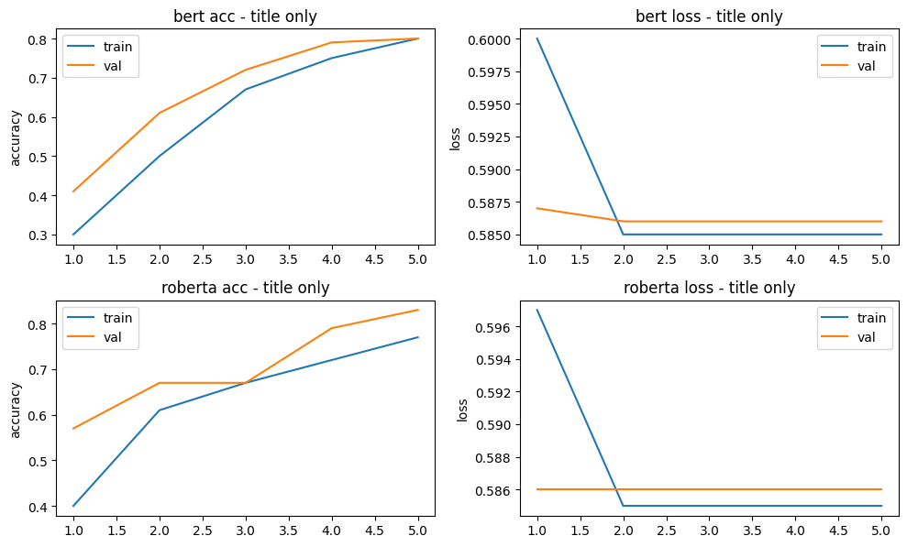
Loss and accuracy when title is passed
Train and Validation loss when title is passed

Slide 10
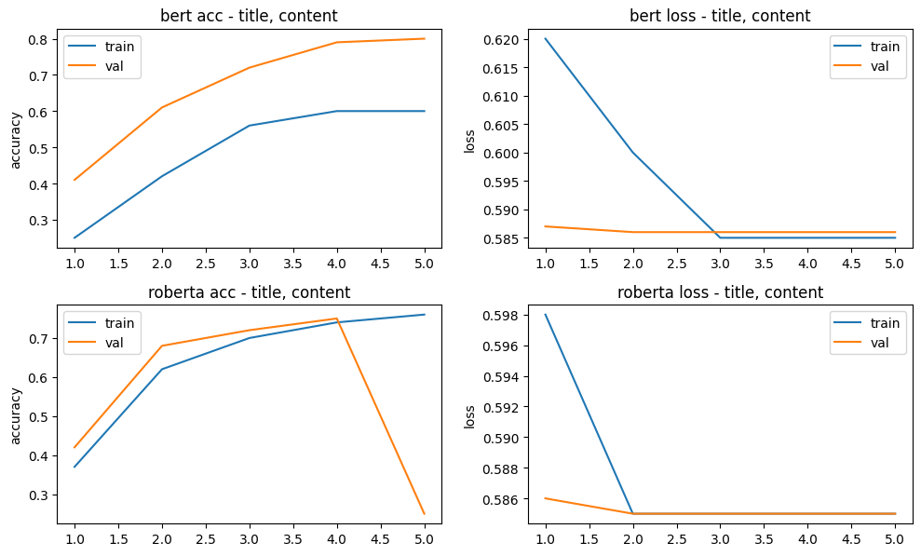
Loss and accuracy when title and content are passed

Slide 11
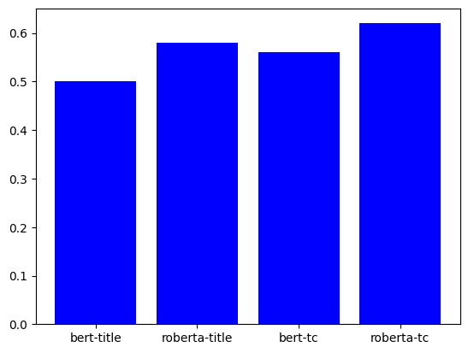
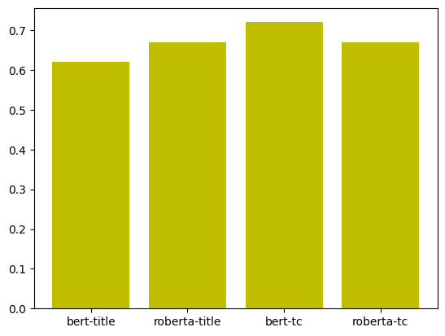
Train and test accuracies
Train Test

Slide 12
Hyper-parameters and evaluation metrics on test set
Loss - Cross entropy; Epochs - 5; Optimizer - Adam
Learning rate - 1e-04, 1e-05
 | Culture | Computers | Sports | Politics
F1 | 0.54 | 0.81 | 0.84 | 0.69
Precision | 0.82 | 0.97 | 0.84 | 0.55
Recall | 0.40 | 0.7 | 0.84 | 0.69

Slide 13
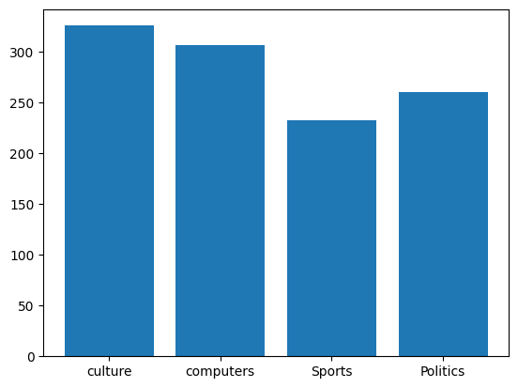
Test accuracies per class
Model | Culture | Computers | Sports | Politics
bert-title | 0.29 | 0.49 | 0.71 | 0.95
roberta-title | 0.05 | 0.83 | 0.81 | 0.93
bert-tc | 0.40 | 0.70 | 0.84 | 0.91
roberta-tc | 0.05 | 0.83 | 0.81 | 0.93

Slide 14
Conclusions
Models with Title and content were performing better than title only models.
All the models seem to be biased on political texts. The base bert-title model predicted almost 75% of the test data to be political.
Poor predictions on culture topic. Potential reasons -
1) Probably need to augment more data on this topic (inherent bias).
2) Higher length of sentences may be impacting. Because sentences of relatively smaller length have better accuracies.

Slide 15
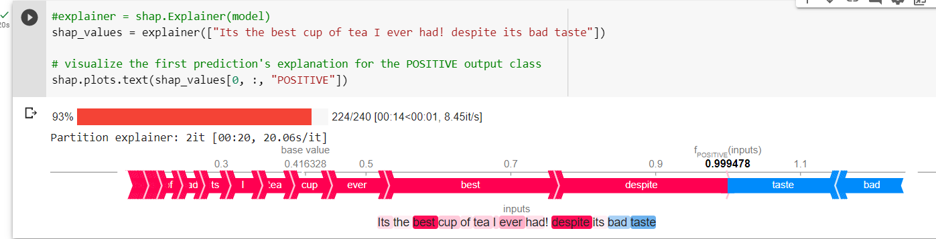
eXplainable AI - XAI (Currently Working)
SHAP

Slide 16
Future Works
Try out unsupervised techniques like LDA, BERTopic and Sentence Transformers.
Explore how the attention layers are behaving by visualizing on platforms like wandb etc.

Slide 17
Our Learnings
Gained good knowledge of NLP techniques and their implementation.
Reading literature about NLP models, best practices and XAI.
What could have been done better if we were to redo?
Pick a different dataset, to spend less time on data cleaning.
Explore few other Transformers like DeBerta, XLnet for classification of text.
Get UMN GPU access.

